Slide 1
Resume Writing and Interview Tips
Brooke Malsberger
Director, Global Talent Acquisition
Lockheed Martin Rotary and Mission Systems

Slide 2
Resume Writing Tips

Slide 3
What is the purpose of a resume?
A resume is your chance to market yourself and secure an interview

Slide 4
What happens when you submit a resume?
Hundreds of resumes are uploaded for one job position.
Recruiters are trained to look at a resume through the hiring manager’s perspective.
Basic Qualifications / Required Skills
Resumes are carefully reviewed by recruiters and down-selected for leader review.
A basic qualifications/required skills search is often completed to filter a large resume pool.
Review
The hiring manager chooses interview candidates from a limited number of resumes.
A best fit hire is chosen from this select number of interviewees.
Interview

Slide 5
So what makes a good resume? How can you get a resume to stand out?

Slide 6
Key Components of a Resume
Contact Information
Summary Statement
Skills
Experience
Education and Credentials
Relevant Activities
(Clubs, Organizations Projects)
The best resume is tailored to the specific job
and company to which you are applying

Slide 7
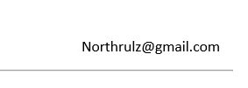
Contact information
John North
John.k.North@gmail.com
123-999-1234
Name should be in large bold font
Phone number with voicemail activated
Appropriate email address that can reliably receive email

Slide 8
Summary Statement
Summarize your credentials, skills and qualifications as they relate to your target position
A motivated self-starter who loves to learn and has an affinity for technical projects. Experience leading class team projects and also work well independently. Experience in Microsoft Excel, PowerPoint, Word, C++, and JAVA. Gaining practical experience, and had an immediate positive impact to the business, as a current Technical Intern for XYZ company.
As a budding engineer, I am seeking the opportunity to work for, learn, and contribute to Lockheed Martin’s programs for it’s customers. My strengths include:
Excellent technical skills
Ability to work in teams
Like to solve hard problems
Strong attention to detail
An honor roll student with experience leading student organizations. Demonstrates a growth mindset, attention to detail, ability to effectively work with others, and loves to contribute to positive outcomes for team goals.

Slide 9
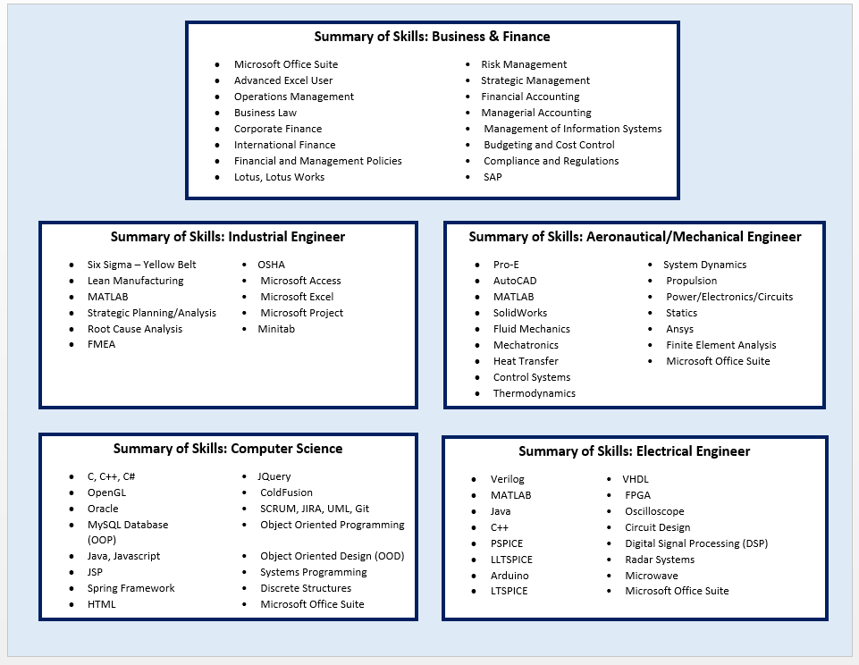
Summary of Skills
Skills can be listed in columns and bullet points for ease of reading, especially in technical fields where skills are often the basic requirements of the job.
Some can be grouped together, like tools, languages and systems. This is a great spot to put relevant keywords from the job description.
The skills to the right are just ideas – you should think through what job-relevant skills you have gained both inside and outside the classroom.
Pro Tip: Think through examples of when you’ve gained/utilize these skills and write it down somewhere. It will help you prep for an interview.

Slide 10
Experience
In descending order (most recent experience to least recent experience), list any jobs you have had, include action verbs, and any achievements
Technical Intern, XYZ Company August 2023 – Present
Utilize coding skills to automate the completion and routing of company work orders to the appropriate point of contact
To date, have reduced work order cycle time by 10% by automating previously manual work order forms
Partnering with company leadership to identity additional processes to automate
Customer Service Representative, XYZ Company June 2022 – August 2023
Worked the in-store customer service desk to resolve customer needs including:
Listened to understand customer needs
Quickly resolved issues including product exchanges, returns, price adjustments, and price matches
Exceeded customer expectations as evidenced by receiving Employee of the Month in September 2023
Optimized back-room inventory by recommending a new layout which led to a 10% improvement in time to return unopened stock to the floor
Yard Maintenance, Self-Employed August 2020 – June 2022
Ensured neighbor’s yards were well-maintained by mowing lawns, pulling weeds, cutting back trees, and other general yard maintenance
Analyzed and set appropriate price by benchmarking competitor prices
Maintained client relationships and high customer service over approximately two years, as evidenced by repeated clients for the duration of the business
Proactively offered yard services before and after hurricanes

Slide 11
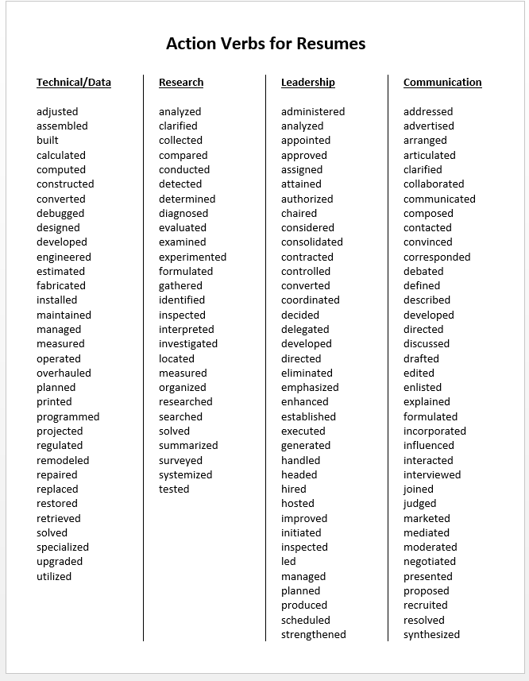
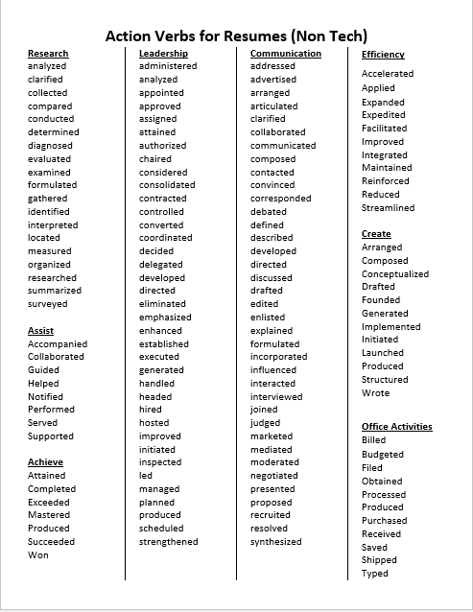
Using Action Verbs
Resumes are all about actions—what you’ve done. Use action verbs when describing an accomplishment. Some examples:

Slide 12
Education
This section should include the Name of the school, Location of the school, Graduation Date, GPA (if higher than 3.0) and any honors and accomplishments
Include coursework only if it is relevant to the job to which you are applying, especially if you don’t have any formal experience in something. For a high school student or new graduate, coursework in certain areas may be all that a hiring manager expects.
If applicable, list certifications/credentials with the accrediting institution and date obtained.
Example:
Education:
High School Diploma
West Orange High School, Winter Garden, FL
Expected Graduation: May 2025
GPA: 3.5
Relevant Coursework:
AP Algebra
Introduction to Engineering
Honors Physics

Slide 13
Coursework and Relevant Activities
If you have other skills or non-work experience that are relevant to the job you are applying for you can add them.
Other skills
Language (level of fluency)
Computer and technical skills (ex. Microsoft Office, operating systems, industry specific software, computer languages)
Professional Associations
Certifications
Non-work Experience
Volunteer Service
Demonstrate skills not listed in work experience
Example:
Other Skills:
Fluent in English and Spanish (written and verbal)
Proficient in Microsoft Excel, PowerPoint, and Word
Includes Excel pivot tables, programming macros, and formulas
Aviation Club, Member (2022- Present)
STEM Club, Member (2022-Present)
Secretary (2023-2024)
Non-Work Experience:
Give Kids the World, Volunteer (2022 – Present)
50 hours to date
Eight Waves, Student Mentor (2023 – Present)
10 hours to date

Slide 14
Strengthen Your Resume
To Strengthen Your Resume
Use basic/key words from your field that will pop out
Quantify the benefits you brought to your current and past programs and managers, use numbers when possible
State your achievements “Initiated process improvements that decreased run-time, resulting in cost and schedule savings”
Use action verbs, specific language: Developed, Cultivated, Created, Analyzed
Buzzwords and Fancy Phrases
Avoid buzzwords that are overused
Say what you mean plainly and simply
Words that weaken your resume include:
Assist, Contribute, Support
Outline HOW you assisted, contributed, supported
What part did YOU play?
How did YOU add value?
How did YOU affect the outcome? Quantify the benefits you brought to your current and past employers

Slide 15
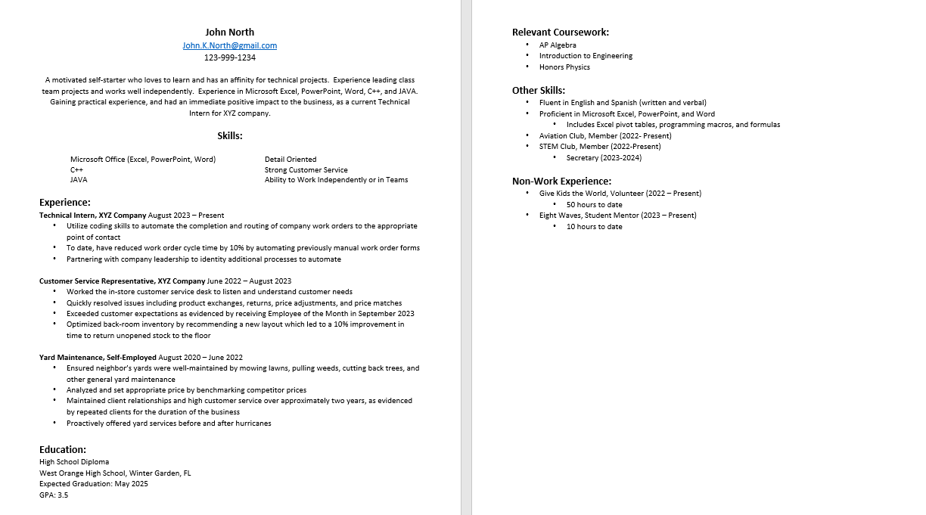
Putting It All Together

Slide 16
a
Dos and Don’ts
Keep your resume to 1-2 pages
Do not include a picture or decorate your resume
Include your cumulative GPA
(if over 3.0)
Do not put anything on your resume you cannot back up with facts
Proofread your resume
Do not rely on Spellcheck alone
Tailor resume for a specific job
Copy a resume from the internet – take the time to make your resume stand out for YOU and what YOU bring to the table

Slide 17
Interviewing Tips

Slide 18
Why Are Interviews Important?
Interviews provide both parties
the opportunity to learn more
about each other
Candidate/Student
Hiring Manager
Learn more about the following topics:
Corporation’s Structure
Job content/ responsibilities
Culture Philosophy
Daily Job Expectations
Leadership Styles
Dive deeper in the following topics:
Candidate’s Experience
Candidate’s Skills
Candidates’ Work Ethic
Candidate’s Education
Job Expectations

Slide 19
Preparing For An Interview
You should be prepared for a variety of interview questions such as:
Anything that’s on your resume (explain experience, skills, projects, etc.)
What courses/classes you are taking or have taken – what did you like/dislike about them?
What was your favorite school project? Why?
What are your strengths and areas of opportunity (i.e. weaknesses)?
Why you’re interested in the role and why you should be selected for the role?
You should also be prepared for Behavior Based questions (i.e. asking about situations and experiences in the past) such as:
Tell me about a time you worked on a team project. What was the project? What was your role? What were the results? What did you like/dislike about the project or experience?
Tell me about a time you had to work with someone who wasn’t pulling their weight on a project. How did you handle it? What was the outcome?
Tell me about a time when you didn’t understand an assignment. What did you do? What was the outcome?
Tell me about a time when you had to make a difficult decision. What was the situation? What did you consider when weight your options? What did you decide? What were the results?

Slide 20
Tips for Answering Behavior Based Interview Questions
Use STAR to frame your response to a question like the plot in a story.
S
ituation: | Explain the situation’s who, what, where, and when.
ask: | Define your role regarding the situation.
ctions: | Describe your thought process as well as the steps YOU took to complete the task and/or solve the problem.
esults: | State the outcome of your actions.
T
A
R

Slide 21
Sample STAR Interview
“Tell me about a time when you demonstrated leadership skills.”
S
T
A
R
“During my last quarter of school, I completed an internship in my home town at a new software firm—Delta. I was the first intern they had, and they decided they wanted to continue with an official intern program.
In order to successfully launch this program, my supervisor asked me to create a training curriculum for the new, incoming interns.
To complete this task, I created a binder that outlined how to access databases as well as how to complete job-related tasks, including the telephone system and copy machines. Next, I created a one-day training agenda to cover these topics and facilitated the training.
The training was a huge success, as each intern rated my communication and leadership style as excellent, and I received a recommendation from my manager.”
Notes:
[

Slide 22
Preparing for an Interview
Practice! Practice! Practice!
Practice! Practice! Practice!
Pre-think of examples you could use for Behavior Interview questions
Prepare answers to other common interview questions
Don’t write a word-for-word script – think about key points and facts that you want to make sure you mention, but let your stories flow naturally from there.

Slide 23
End of Interview: Asking Questions
Suggested questions:
When should I expect to hear an update about the position?
What knowledge/skills should I work on obtaining prior to the role?
I understand this is a challenging role. Are there any steps I should take to aid in my success for this position?
Is there anything I haven’t asked you today that you would like to talk about?

Slide 24
After the Interview: Send a Thank You Note
Remember to be friendly and thank them for their time
The thank you email should touch on something specific that you talked about in the interview to help the interviewer remember exactly who you are
The email should strike a balance between talking about what you would gain from having this job and what they would gain from you being in this position
Double check for spelling and grammar before sending
Ideally, send this email within the 24 hours after your interview

Slide 25
Interview Tips and Best Practices
Dress business professional
Don’t be late
Remember to smile and use eye contact
Feel free to take notes about things they mention
If you aren’t sure how to answer a question:
Take a sip of water as you consider your answer
Say “Wow that is a really great question, may I have a second to think about that?”
If you are unsure what they are asking, you can clarify by saying “Would you like me to tell you about…”

Slide 26
Virtual Interview Tips
Test technology before your interview
Virtual interviews require tools like a camera and microphone on your personal device.
Check at least one day prior to interview if technology is working properly.
Adjust your video image (shrink yourself and make the other party larger).
Dress professionally
You should dress the same as you would in a face-to-face interview.
Dress for success, solid colors look best.
Minimize distractions around you
Choose a room that is clean, quiet, and professional looking so the interviewer can focus their attention on you and not what is around you.
Try to place your device on table or desk instead of your lap or couch.
Be aware of your surroundings.
Make sure the lighting is good and there is nothing distracting behind you.
Be sure you are in a quiet area where no one can bother you during your interview.
Continue to be authentic
Be sure to look into the eye of the webcam when talking.
Show your true self. You might not be there physically but you can show your personality.

Slide 27
Soft Skills Certifications:
Conveying Professionalism – Dependability, courtesy, attitude, motivation, personal accountability, and time management.
Communicating Effectively – Verbal and nonverbal communication and listening; use of communication tools including email etiquette, cell phone, and social networking; resolving conflict; and acknowledging criticism.
Promoting Teamwork and Collaboration – Teamwork skills and interactions, benefits of diversity and sensitivity to differences, accepting responsibility, and leadership.
Thinking Critically and Solving Problems – Innovation, creativity, flexibility, overcoming adversity, goal setting, and critical thinking strategies.
Employability Skills Certifications:
Work Ready Math builds mathematical reasoning and problem-solving skills to prepare learners to solve real-life workplace problems, such as calculating dimensions, costs, and percentages; reviewing transactions to ensure accuracy; and comparing rates.
Work Ready Reading builds reading comprehension and reasoning skills to prepare learners to utilize documents in the workplace, such as memos, letters, directions, signs, notices, policies, and regulations. Skills include obtaining and applying new vocabulary; following complex instructions; and understanding policies and procedures.
Work Ready Data builds analytical skills to prepare learners to interpret sources of data in the workplace, such as charts, graphs, tables, ﬂowcharts, diagrams, and maps. Skills include identifying trends among variables, recognizing significant and extraneous data points, and drawing conclusions from one or more sources of data.
Overview: Go to minute 28:24: https://vimeo.com/866877868?share=copy
Website: https://www.floridareadytowork.com/

Slide 28
Thank you for your time!
What questions do you have for me?

